Slide 1
ChASHM
Group Members:
Hashim Mahmood
Ali Amir
Nirmal Rai

Slide 2
Project Introduction
Chashm is a personalized learning facility for visually impaired students.
The project aims to counter the extremely low literacy rate of visually impaired students in Pakistan.
It is a complete digital solution to provide self-paced learning to visually impaired students.

Slide 3
FYP details
This project is currently under development by students of CS-9 batch as their FYP.
Original Team:
Muhammad Sharjeel Maqsood (307550)
Hamza Mushtaque (288114)
Muhammad Muzammil Malik (288768)

Slide 4
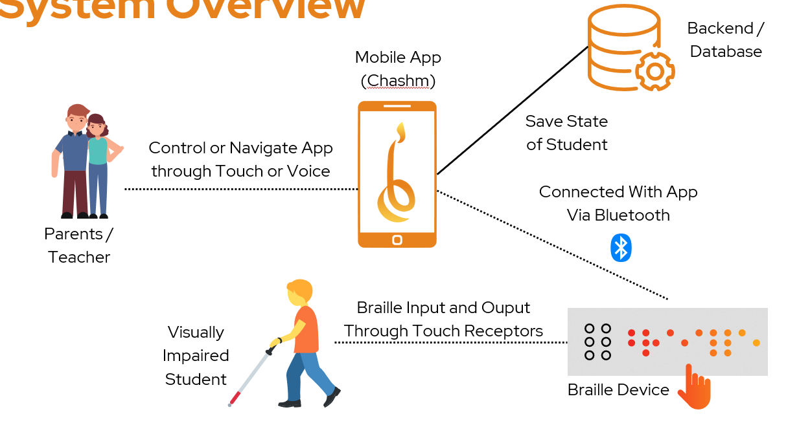




System Overview

Slide 5
Core functional requirements
Multi-user mobile application
Connectivity with wireless Braille Keyboard Device (BKD)
Student and Teacher dashboard
Course-related activities e.g., lessons, tests, grades
Database storage of all user data
Host server to drive all components

Slide 6
Non-functional requirements
Portability – usage anywhere, anytime
Scalability – flexible in terms of size or nature of course
Security – selective grant of access to user data
Interoperability – cross platform, BKD connectivity

Slide 7
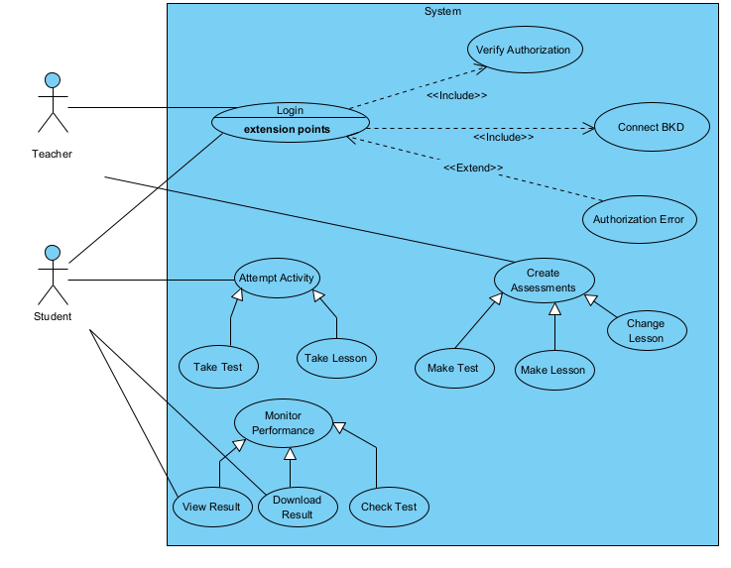
Use case diagram

Slide 8
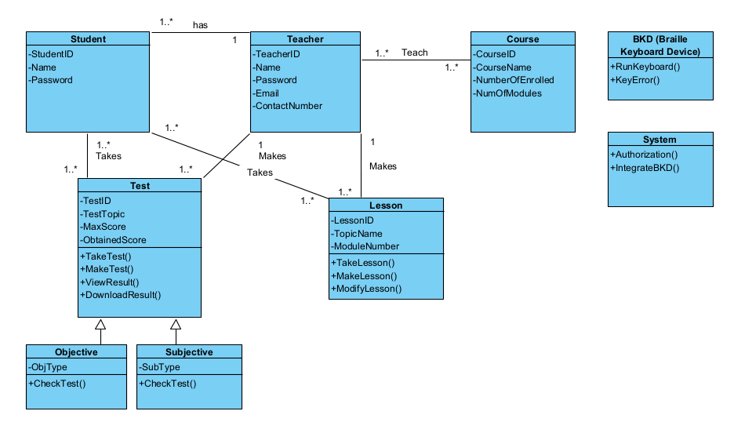
Class diagram

Slide 9
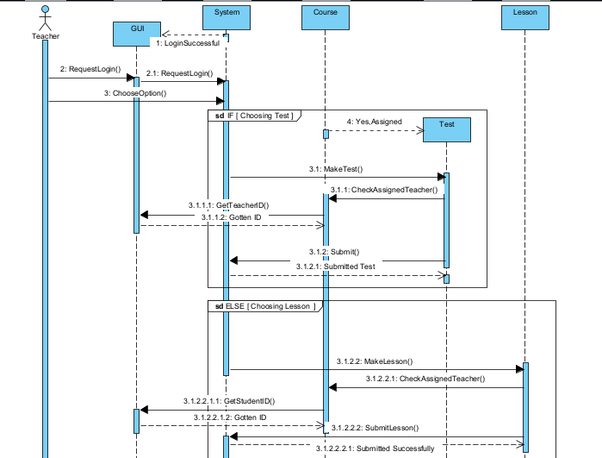
Sequence diagram #1

Slide 10
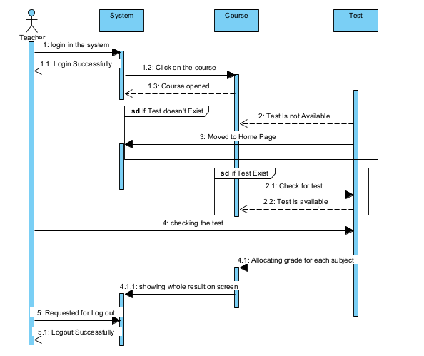
Sequence diagram #2

Slide 11
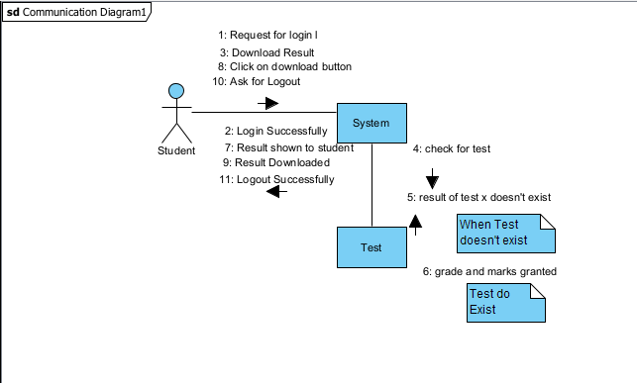
Communication diagram

Slide 12
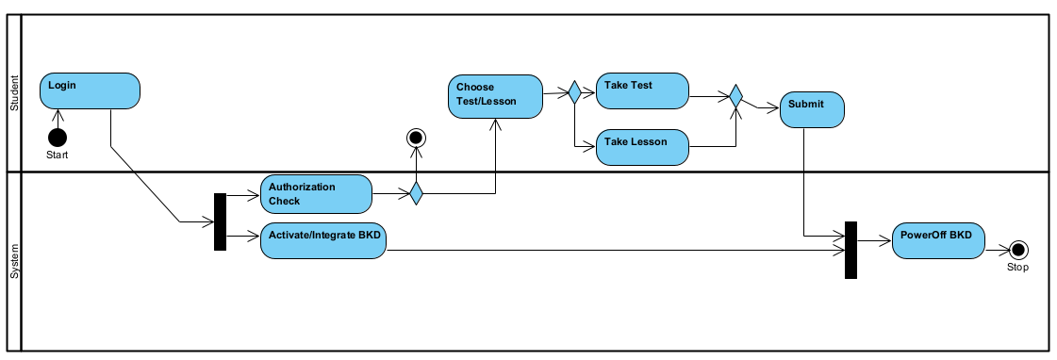
Activity diagram

Slide 13
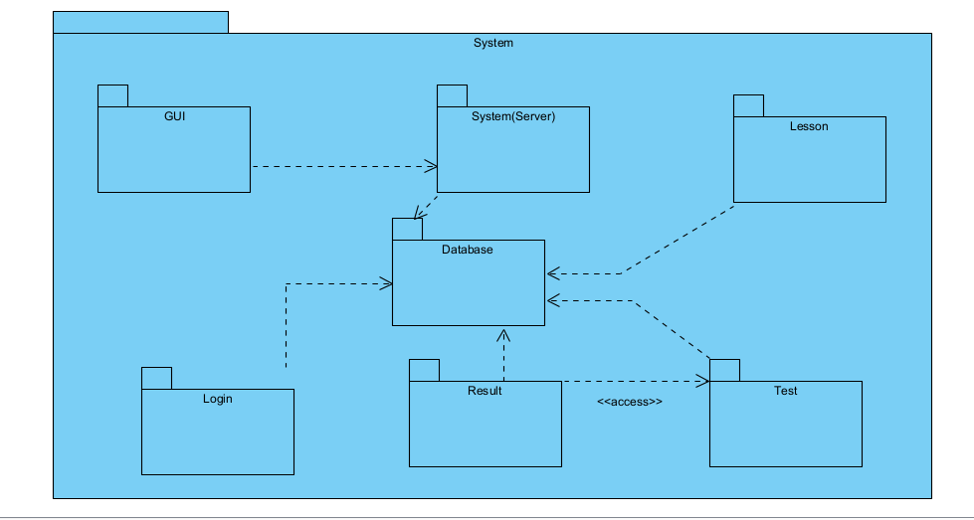
Package diagram

Slide 14
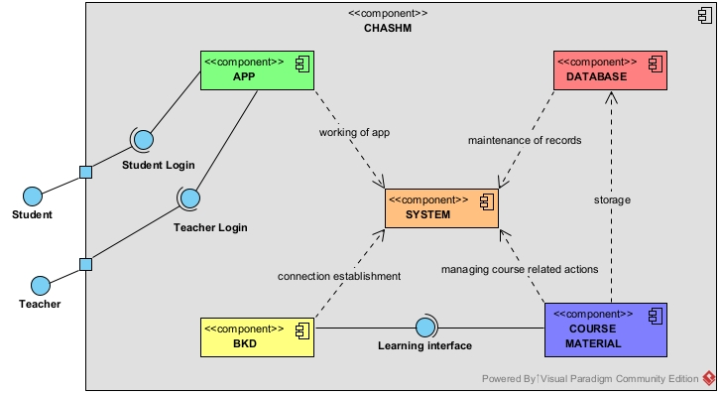
Component diagram

Slide 15
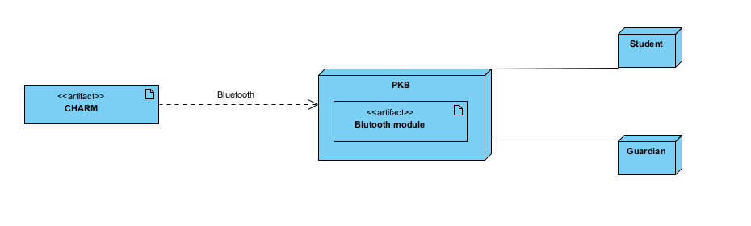
Deployment diagram

Slide 16
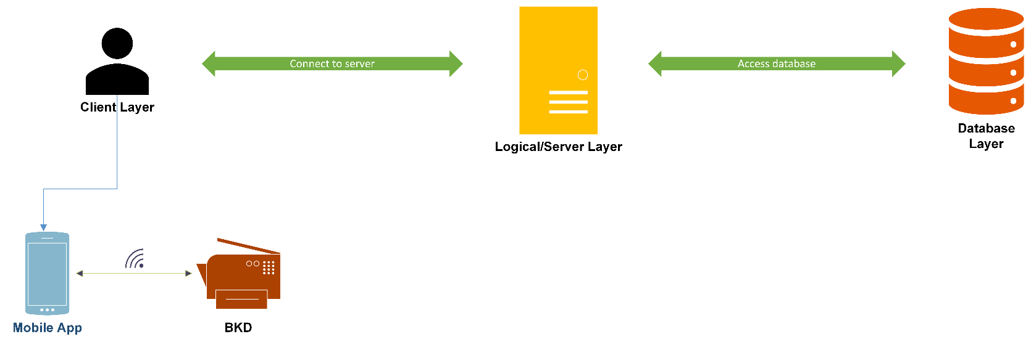
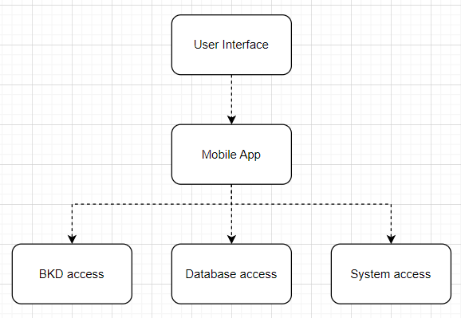
Overall system architecture

Slide 17
Thank you
Questions ?

